Slide 1

TRUSTEE PACK
May 2026

Slide 2



Join us in shaping the future of the Woodfield Pavilion

Slide 3
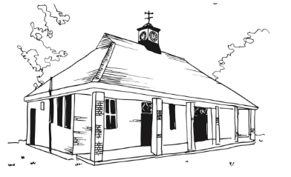
The Woodfield Project (TWP) is a registered charity.
Our trustees are responsible for the management of The Woodfield Pavilion, a refurbished 1933 sports pavilion on Tooting Bec Common which now operates as a community centre. We are currently looking for a number of new trustees
Our charity is deeply committed to creating a vibrant and welcoming space where local people can come together and enjoy a wide range of activities. We aim to offer opportunities for connection and enrichment, all while fostering an appreciation for the unique natural beauty surrounding Woodfield Pavilion.
We are focused on:
Long-term sustainability
Strong governance and compliance
Community engagement and accessibility
Maximising use and impact of the building
Find out more about the charity here.

Slide 4
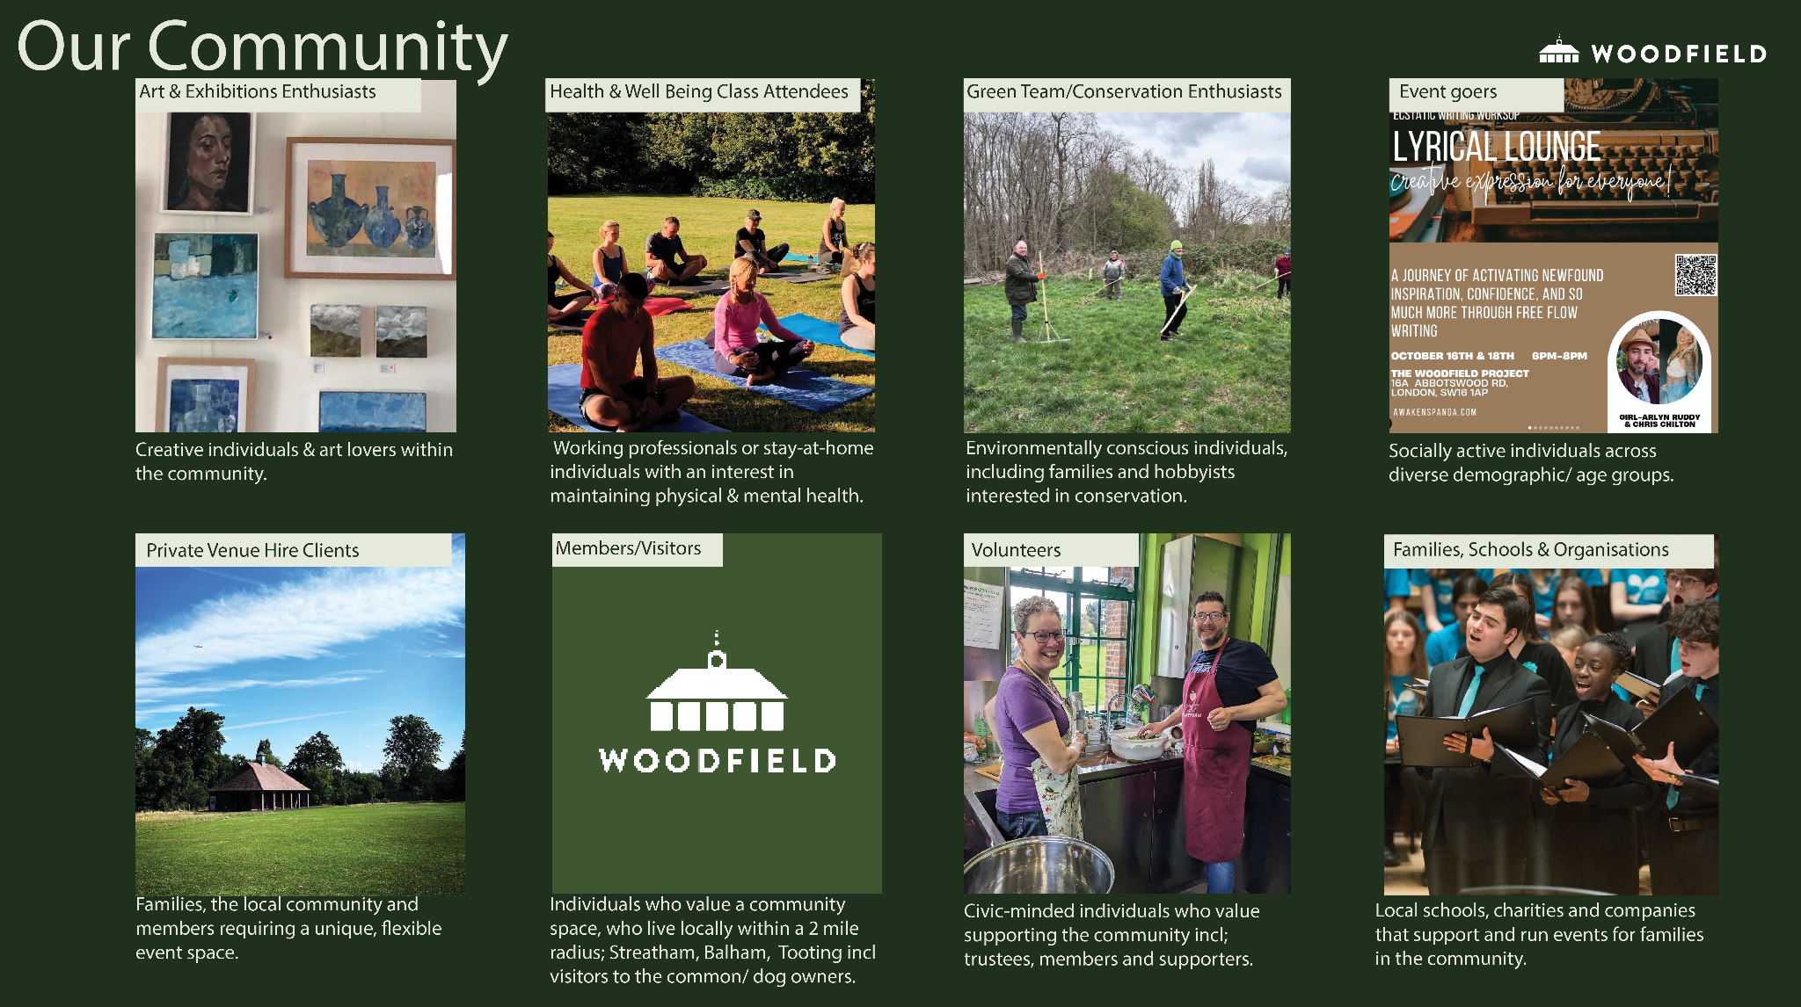

Slide 5
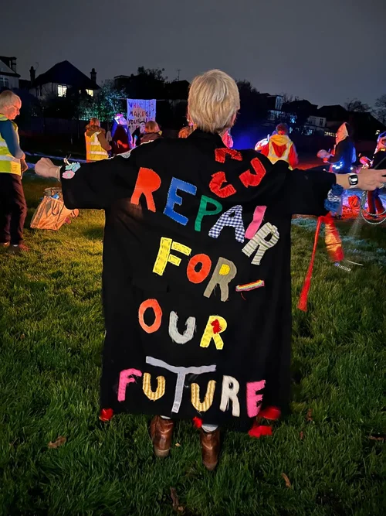
Being a Trustee
Our trustees play a vital role in making sure that The Woodfield Project (TWP) achieves its core purpose. They oversee the overall management and administration of the charity. They also ensure that TWP has a clear strategy and that our work and goals are in line with our vision. Just as importantly, they support the Manager, staff and volunteers to enable TWP to grow and thrive.
As we are a small charity, all trustees will need to be actively involved beyond Board meetings. This may involve drafting or scrutinising board and other papers, leading or contributing to organisational sub-committees leading or contributing to discussions, providing leadership and/or advice and guidance on specific initiatives or issues, and contributing to or leading in other areas in which the trustee has special expertise.
What You Will Gain
Opportunity to apply your skills in a meaningful context
Involvement in shaping a high-potential community organisation
Collaboration with a committed and purpose-driven team
Board-level charitable governance experience

Slide 6
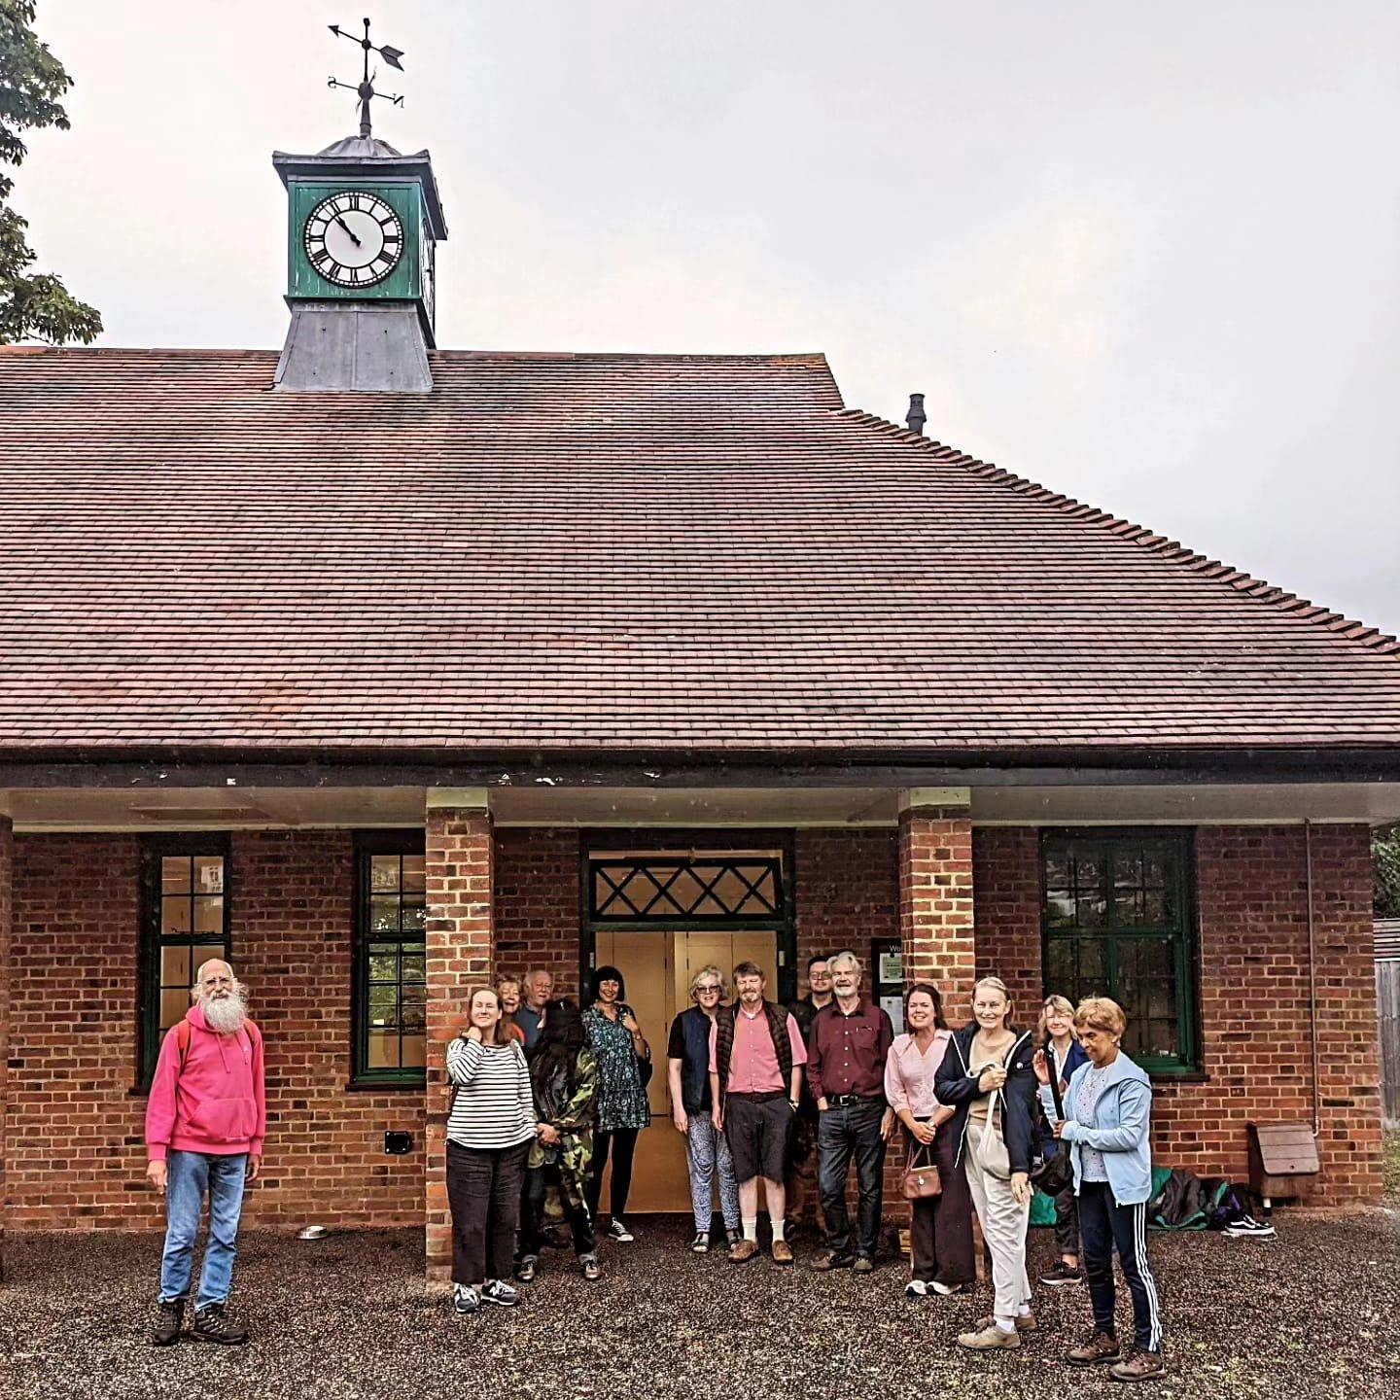
We are seeking individuals who:
Bring relevant experience, professional or otherwise
Can think strategically and exercise sound judgement
Are collaborative and able to challenge constructively
Are committed to community impact
Live or work locally to The Woodfield Project
We particularly welcome experience in finance, property, strategy, legal or communications.
Vacant roles - see below for more information about these roles
Chair
Treasurer
Ordinary trustees
Time Commitment
Approx 4 hours per week
Quarterly Board meetings
Annual General Meeting
Induction and training in the role and responsibilities of a trustee will be provided

Slide 7
We are particularly interested in people with the following skills:
Our organisation places people in teams with other trustees & volunteers so that everyone can make the best use of their professional & other experience.
Our teams: Strategy Team (long-term vision, impact & organisational direction), Finance Team (financial stewardship, compliance & sustainability), Buildings Management Team (safe, efficient and sustainable management of the Woodfield Pavilion), Communications Team (visibility, engagement & community connection), Green Team (sustainability & the environment)
Leadership
Governance
Strategic development and planning
Management
General / operations management
HR
Project / programme management
Volunteer management
Finance
Accountancy / Auditing
Bookkeeping
Financial management
Organisational policy
Data protection / GDPR
Health and safety
Safeguarding
Communications and Marketing
Event management
Marketing strategy
Public relations
Social media marketing
Income generation
Business development / Sales
Fundraising events
Fundraising research / Bid writing
Fundraising strategy
Property
Building and Property management
Procurement
Fundraising
Legal

Slide 8

Join us in shaping our future!
How to Apply
Please submit a short expression of interest outlining:
Your background and relevant experience
Whether you are interested in the role of Chair, Treasurer, or ordinary trustee (you can state an interest in more than one role).
We welcome informal enquiries and conversations prior to applying.
Email applications to: admin@thewoodfield.org

Slide 9
TRUSTEE ROLES AND OUR CHARITY

Slide 10
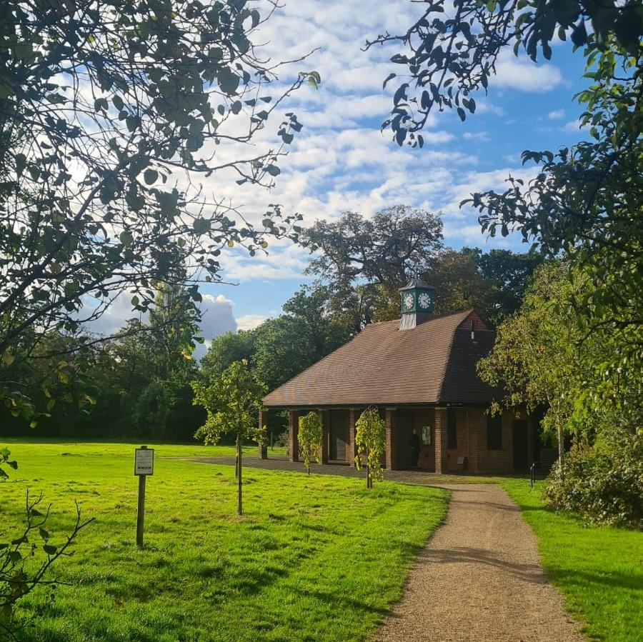
General Trustee Role and Responsibilities
Support and provide advice on TWP’s purpose, vision, goals and activities.
All board members have a collective responsibility to always act as a group and not as individuals.
Approve operational strategies and policies, and monitor and evaluate their implementation.
Oversee TWP financial plans and budgets and monitor and evaluate progress.
Ensure the effective and efficient administration of the organisation.
Ensure that key risks are being identified, monitored and controlled effectively.
Review and approve financial statements.
Provide support and challenge to The Pavilion Manager in the exercise of their delegated authority and affairs.
Keep abreast of changes in TWP operating environment.
Contribute to regular reviews of TWP own governance.
Attend Board meetings, adequately prepared to contribute to discussions.
Use independent judgment, acting legally and in good faith to promote and protect TWP’s interests, to the exclusion of their own personal and/or any third party interests.
Contribute to the broader promotion of TWP objects, aims and reputation by applying your skills, expertise, knowledge and contacts.

Slide 11
TRUSTEE ROLES
Chair
Role Description
The Chair leads the board, ensuring that it governs the charity effectively, in service of the charity’s vision and mission. The Chair leads in an inclusive way, supporting the board to work together well, providing challenge as necessary. The Chair is also an ambassador for the charity.
Chair role
Provide strategic leadership to the charity and the Board, ensuring that The Woodfield Project (TWP) achieves its mission.
Work in partnership with the Manager, staff, and volunteers to achieve our mission.
Lead the board in ensuring that it fulfils its responsibilities for the governance of the organisation.
Optimise the relationship between the board and TWP’s staff and volunteers.
Plan and chair the board meetings and the AGM, with others as appropriate.
Advise, support and give consent as required for the effective operation of TWP.
Act as a spokesperson and figurehead for TWP.

Slide 12
TRUSTEE ROLES
Chair
Qualities
A keen sense of strategic purpose.
An inclusive leadership style: able to inspire and support everyone to participate on an equal footing.
The ability to listen and engage effectively. You are comfortable with challenge and debate and are able to encourage that in others whilst fostering a collaborative board environment.
Advocacy - be able and willing to champion TWP’s work through personal networks, social media, and other channels.
A strong personal commitment to equity, diversity and inclusion.
The ability to be responsive to the demands of the role. You can respond in a timely fashion to queries and communications and are able to take decisions where necessary.
It’s desirable, but not essential to have experience of being a trustee. (You do not need to have been a Chair before.)
In addition to the above, the Chair will have the responsibilities and qualities of all trustees – see Trustee Role Description for details.

Slide 13
TRUSTEE ROLES
Treasurer
Role Description
Below is an overview of key areas where contribution is required:
Overseeing the preparation and presentation of budgets, forecasts, management accounts and annual financial statements to the Board.
Maintaining accurate accounting records that meet the requirements of accounting and charity regulations
Ensuring that robust and comprehensive financial policies and procedures are in place and adhered to
Administration and management of the charity’s bank accounts
Compliance with the requirements of other organisations and statutory bodies
Advising on and supporting the development of strategic plans, projects, activites, grant applications and fundraising
Appraisal, mitigation and reporting of risk management

Slide 14
TRUSTEE ROLES
The Treasurer
Qualities
Background in accounting, finance, bookkeeping or other highly numerate environment
Knowledge and experience of budgeting/forecasting and financial reporting
Analytical mindset and attention to detail
Strategic thinking and ability to balance risks and opportunities
Ability to explain financial information to non-finance specialists
Understanding of charity or non-profit finance (desirable)
In addition to the above, the Treasurer will have the responsibilities and qualities of all trustees – see Trustee Role Description for details.

Slide 15
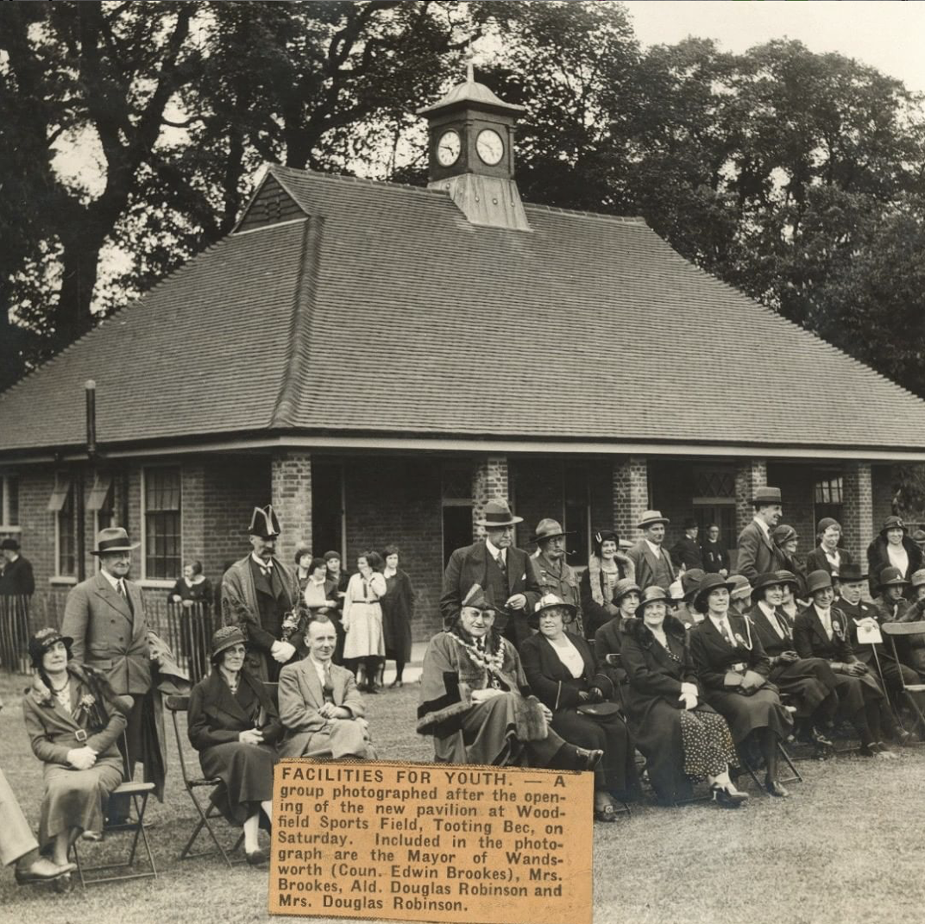
More about The Woodfield Project
The Woodfield Project is registered charity no. 1158644. It was set up in 2014 to restore the Woodfield Pavilion and reopen it as a community space. The charity has a trustee board of a maximum of fifteen trustees, including twelve elected trustees and up to three trustees nominated by local bodies such as the Tooting Commons Management Advisory Committee and Wandsworth Council. The charity’s total income in 2025, including restricted funds, was £87,135.
The Woodfield Pavilion is a beautiful refurbished community space serving the communities of Tooting Bec Common and surrounding areas. It is owned by Wandsworth Council, but is situated in Lambeth. Woodfield is an enclosed green field, flanked on two sides by the gardens of houses in Abbotswood Road, on another by the playing fields of Streatham and Clapham Girls High School and on the last by Tooting Bec Common. The pavilion was opened in 1933 to provide changing facilities for the young people and others when they used the field for sports and other activities.
The Pavilion reopened in 2019 and since then the Charity has employed a full time Pavilion Manager reporting to the Trustees, and, more recently, a part-time Digital Assistant. The trustees and the Pavilion Manager are supported by volunteers drawn from the 372 members who support the Project via a small annual payment.
Find out more about The Woodfield Project here: https://www.thewoodfield.org/

